Slide 1

NServiceBus and Service Fabric
daniel.marbach@particular.net @danielmarbach
bob.langley@particular.net
@boblangley

Slide 2
A Tale of
chocolate
Notes:
We have a serious problem in Switzerland!
Our chocolate is so good that the international demand is raising
Chocolate manufacturers in Switzerland realized need for Highly reliable chocolate order management system
The team responsible for the new order management wanted to go for Platform as a Service
but unfortunately they have a few legacy infrastructure pieces that can’t be moved to PaaS just yet
Karl, the ivory architect of the team watched a webinar with Matt Snider about Service Fabric and he felt it is the perfect fit for the new order management system
He gave a sales pitch about Service Fabric

Slide 3
A few hours
later…
Notes:
Of course Karl’s sales pitch went on and on and on, after all isn’t that what all ivory architects do, talk, talk, talk and get nothing done?
Of you want to known what the team architect explained I suggest you rewatch the last webinar, after all he recited everything Matt already told us ;)

Slide 4
Microservices 1.0
Notes:
Karl the team architect proposed to use a stateless architecture using Stateless Services. The data would be stored in a database and shipped between the stateless tier using the Data Shipping Paradigm. After all stateless is supposed to be THE THING with the rise of Microservices and HTTP
In their first architecture approach the team went with the proposal from Karl, after all Architect’s are always right, right, right???

Slide 5
SF Cluster
DB Cluster
Stateless
Stateless
ASP.NET Core MVC
ASP.NET Core WebApi
Front
Back
Storage
Order / Query
Read / Write
RPC over HTTP
Entity FW
Notes:
Stateless FrontEnd with ASP.NET Core
Orders and Queries for Orders use RPC over HTTP (Microservices is all HTTP, the hipster protocol of the twenty first century)
The front end communicates with the stateless web API the serves data from the storage tier out of the DB cluster
The API controllers use EntityFramework and transactions for read and write

Slide 6
SF Cluster
DB Cluster
Fabric DNS or Reverse Proxy
Where is the backend?
Front
Back
Storage
Front
Back
Front
Back
HttpClient
Kestrel
EF
Well, here it is!
Notes:
The front-end uses an HTTP Client to initiate the communication with the backend.
The backend location is not known up front and needs to be discovered via the buil-in Fabric DNS and communication can happen over the built in reverse proxy if the backend is scaled out.
The backend exposes the web API with uniquely identifiable and addressable kestrel listeners
Nuff said, let’s dive into what the team built

Slide 7
Demo
Notes:
Let’s see what the team came up with.

Slide 8
The RPC callstack of
doom
Notes:
The team realized although with Service Fabrics high availability and the built in retries on the http client communication layer their architecture approach was not quite there yet where it should be in terms of scalability.
Because of the RPC call chain when ever the latency between the DB cluster and the backend was slow or there was a concurrent update on a row those effects rippled through the callstack to the issuer of the call, which is the front-end.
Furthermore on every request from the front-end a new database transaction was created and when many operations were pending those transactions sometimes rolled back or slowed down the order processing
The temporal and special coupling introduced was horrible. The latency of the storage layer directly influenced the customer facing latency.
SLA couldn’t be fulfilled
Orders got lest when the client of the request stopped retrying
Orders could not be throttled and worst the actual order intent was difficult to find in HTTP callstack exception logs

Slide 9
Microservices 2.0
Notes:
So they started brainstorming an additional architecture approach and freed themselves from the ivory architect (just kidding) The domain of order processing is a good domain to apply messaging because every order can be answered with “thank you we will shortly process the order”

Slide 10
SF Cluster
DB Cluster
Stateless
Stateless
ASP.NET Core MVC
ASP.NET Core WebApi
Front
Back
Storage
Query
Read / Write
RPC over HTTP
Entity FW
Order
Messaging Cluster
Queue
Notes:
The stateless frontend tier and the stateful middle tier with the compute remains the same. But between the stateless and the stateful tier we should introduce some kind of broker middleware like Azure Service Bus, Azure Storage Queues or RabbitMQ for on-premises. The broker middleware will contain a queue for our chocolate orders. Of course not everything has to go through the queue. Only things like orders that need to be processed in order and potentially throttled. After all it is better to process orders a bit later than loosing them right? Orders like a swiss clock. With that we get
Decoupling especially temporal
Awesome scaling
Throttling
Retries and business transactions to stateful middletier
Intent capturing request as messages
Reactive

Slide 11
SF Cluster
Send-only endpoint
Full endpoint
Front
Back
Startup
Listener
Messaging Cluster
Queue
Notes:
The Frontend uses the OWIN startup listener to bootstrap the communication infrastructure with the queuing system
The front end only sends messages to the destination and doesn’t need to listen for messages itself in their architecture
The backend uses the communication listener to enable the queue listener since the backend is the part which processes orders

Slide 12
SF Cluster
DB Cluster
Competing consumers
Front
Back
Storage
Front
Back
Front
Query
Back
Order
Messaging Cluster
Queue
Notes:
With the scaled out approach multiple instances of the front end will send orders to the queue while multiple competing consumers will fetch messages from the queuing system on the backend. So with each backend instance we can essentially linearly scale the backend processing power up to the capacity of the queuing system

Slide 13
Demo
Notes:
Let’s see what the team came up with.
The team decided to use NServiceBus because they wanted to focus on the business logic, use a framework that is battle tested, not write plumbing code and work with a company that provides world class enterprise support

Slide 14
almost
a happy life
Notes:
The solution was working well for the team. The reduced temporal coupling, the retries and the throttling capabilities it the system really robust and stable. One problem remained though
(Click)
The realized with the increased demand in Swiss chocolate their scaling needs starting to grow and grow. The storage layer become more and more the bottleneck because it had to be consulted on every request from the query side but also from the command handling side. The team started to think about adding a caching layer between the storage tier and the backend to achieve the required hyperscale.
When they started talking about caches they realized that cache invalidation is an immensely complex problem and requires usually a consensus approach to keep it current and up to date. With a caching layer they would potentially also loose the transactional semantics of the storage layer but then the remember that Service Fabric has built in partitioning and reliable collections that comes with stateful services.
(next)

Slide 15
almost
a happy life
Notes:
Concept of stateful services, Stateful Services allow to consistently and reliably store state right inside the service by leveraging the power of reliable collections. They have a similar API to C# collections but are offer transactional semantics as well as replication inside the cluster. With that we can achieve:
Application hot state lives in the compute tier
Low latency reads and writes
Transactional
Fewer moving parts
External stores are only used for exhaust and offline analytics
Capacity in cluster is limited compared to the storage tier (tradeoff)
Mention orders in memory
Conceptually, you can think about a partition of a stateful service as a scale unit that is highly reliable through replicas that are distributed and balanced across the nodes in a cluster.
Partitioning in the context of Service Fabric stateful services refers to the process of determining that a particular service partition is responsible for a portion of the complete state of the service.
A great thing about Service Fabric is that it places the partitions on different nodes.
This allows them to grow to a node's resource limit. As the data needs grow, partitions grow, and Service Fabric rebalances partitions across nodes. This ensures the continued efficient use of hardware resources.

Slide 16
Microservices 3.0
Notes:
They decided to address this and started building their new solution with a stateful backend using reliable collections

Slide 17
SF Cluster
DB Cluster
Stateless
Stateful
ASP.NET Core MVC
ASP.NET Core WebApi
Front
Back
Cold Storage
Query
RC
RPC over HTTP
Order
Messaging Cluster
Queue
Notes:
The backend is turned into a stateful service and uses a Reliable Collection to store the orders
Queries are executed against the reliable collection
Orders are still submitted over the queue but now the handler no longer accesses the database but the reliable collection to effeciently and transactionally store orders
The storage tier is only needed for exhaust or offline analytics purposes
For simplicity reasons this picture doesn’t take partitioning into account. Let’s see how partitioning influences the query side

Slide 18
Back (Part 1)
RC
Front
Back (Part 2)
RC
Back (Part 3)
Fanout Querying
RC
Notes:
Because the data is now split over multiple partitions on multiple nodes a query has to fanout to all the partitions owning the data when it wants to present all the data form all the partitions

Slide 19
Logical Receiver
Back-Part1
Back (Part1)
RC
Order
Cmd
Back-Part2
Front
Back (Part2)
RC
Back-Part3
Back (Part3)
Sender Side Distribution
RC
Notes:
The UI composite for issuing orders in the order management microservice will issue a command to the order backend part.
Since they belong to the same bounded context it is OK to use commands.
When sending a commend the sender knows the receiver or at least the logical destination (here the queue). With that we can decouple the order sending temporarily from the order receiving.
In that case it is OK for the sender to know the data partition function the maps the input data to the partition key.
Integration scenarios, a command sender is not part of the cluster but still belongs to the same bounded context
For simplicity reasons let’s call this Sender Side Distribution.

Slide 20
Logical Subscriber “Shipping”
Different bounded context
Shipping-Part1
Shipping (Part1)
OrderAccepted
Evnt
Shipping
Back
Shipping-Part2
Shipping (Part2)
Receiver Side Distribution
Notes:
For PubSub the subscriber is abstracted behind a logical thing like a logical queue or a topic or exchange.
The fact that a subscriber is scaled out is not visible to the publisher.
For non-data replication scenarios usually a single physical subscriber of a logical group gets the event.
Since they act as competing consumers a message can be picked up by any subscriber. The subscriber then recalculates the data partition key by using its internal data partitioning function.
If the key matches the current partition everything is good. If not the event is internally rerouted with a single hop.
(click)
Even when publisher is its own subscriber this has to be applied

Slide 21
Demo
Notes:
Let’s see what the team came up with.

Slide 22
Stateful computation with low latency requires smart routing
Service Fabric with stateless and stateful services combined with messaging gives you best of two worlds
Recap

Slide 23
Slides, Links…
github.com/danielmarbach/service-fabric-webinar
Notes:
Questions that can be answered in blog posts

Slide 24
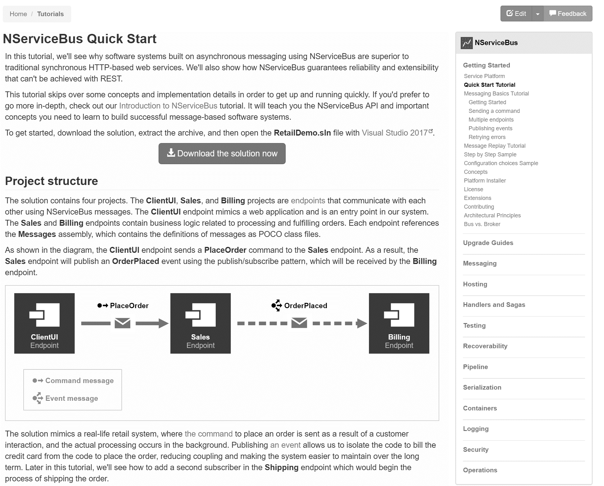
docs.particular.net/ tutorials/quickstart

Slide 25
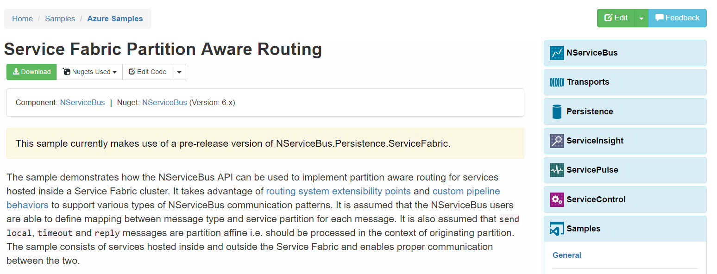
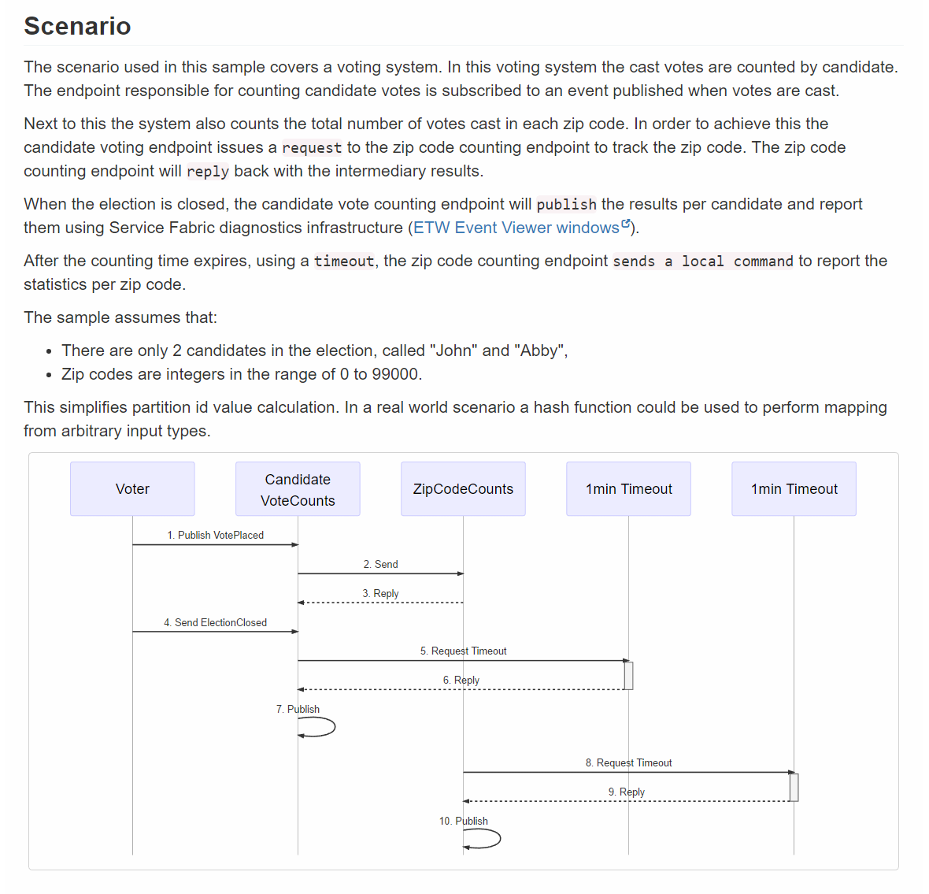
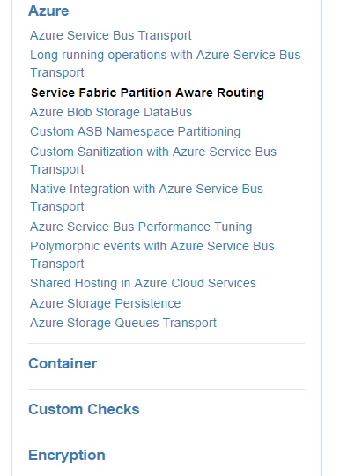
docs.particular.net/ samples/azure/azure-service-fabric-routing/

Slide 26
Q & A

Slide 27
daniel.marbach@particular.net @danielmarbach
bob.langley@particular.net
@boblangley

Slide 28
Thanks
Notes:
Thank you very much for listening and see you next time

